Slide 1
Sometimes it only takes one image...
Hi, Taxpayer!
Don’t forget to check your email inbox!
Please call with any questions!
Thank you,
Tax Collector
* See next slide!

Slide 2


Slide 3


Hello! We’re the Elizabeths
Elizabeth Doss
Assistant Chief Deputy
Property Tax Division
Harris County Tax Office
Elizabeth Wiehle
Partner
Perdue Brandon
Fielder Collins & Mott, LLP

Slide 4
The Future of Online Property Tax Administration
01
02
03
Electronic Tax Communications
HB 1228
Harris County
Tax Office (HCTO)
e-Bill process
Online Property
Tax Services

Slide 5
YOU’VE GOT
MAIL!
…e-mail

Slide 6
01
Electronic Tax Communications
The Law…
Section 1.085 (as amended by HB 1228)
Effective Jan 1, 2024
Requires all Tax Officials to send communications electronically … if the property owner elects to receive electronic communications, it must be made in writing on a form prescribed by the Comptroller and remains in effect until rescinded in writing by the property owner or owner’s agent.
“Tax officials(s)” - chief appraiser, appraisal district, ARB, assessor, collector or taking unit
“Communications” – notice, application, tax bills, renditions and other items of information
Tax official must post notice of how a property owner can make such an election on their website and in their office.
The tax official must specify the way the communications will be exchanged and the method that will be used to confirm the delivery of communications.
John K. Smith
123 Main St.
Houston, TX 77002

Slide 7
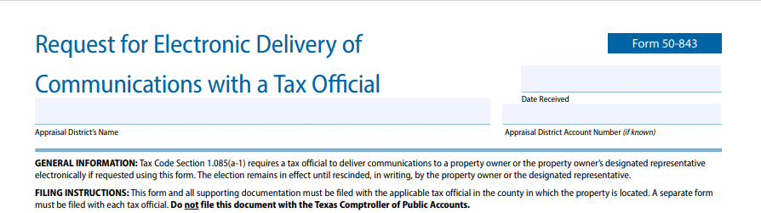
Electing to receive e-communications
What are the acceptable forms to request e-communications?
Comptroller Form
Property owner emails request?
Property owner mails a letter?
Request must be in writing!
John K. Smith
123 Main St.
Houston,TX 77002

Slide 8
Electronic Tax Communications
Delivery by
Property Owner
Duration of Election
An electronic communication sent by a property owner is timely… only if it is addressed to correct email address or delivery portal/system AND is received by the tax official’s server on or before the due date
Tax officials must acknowledge receipt of any electronic communication sent by a property owner.
Delivery by
Tax Official
A property owner’s election to receive electronic communications remains in effect until it is rescinded in writing
New Email Address
An electronic communication sent by a tax official is considered delivered as of the date it was sent.
Must be sent to the correct email address
Property owner is required to notify tax officials of any change in their email address
Tax officials should do the same

Slide 9
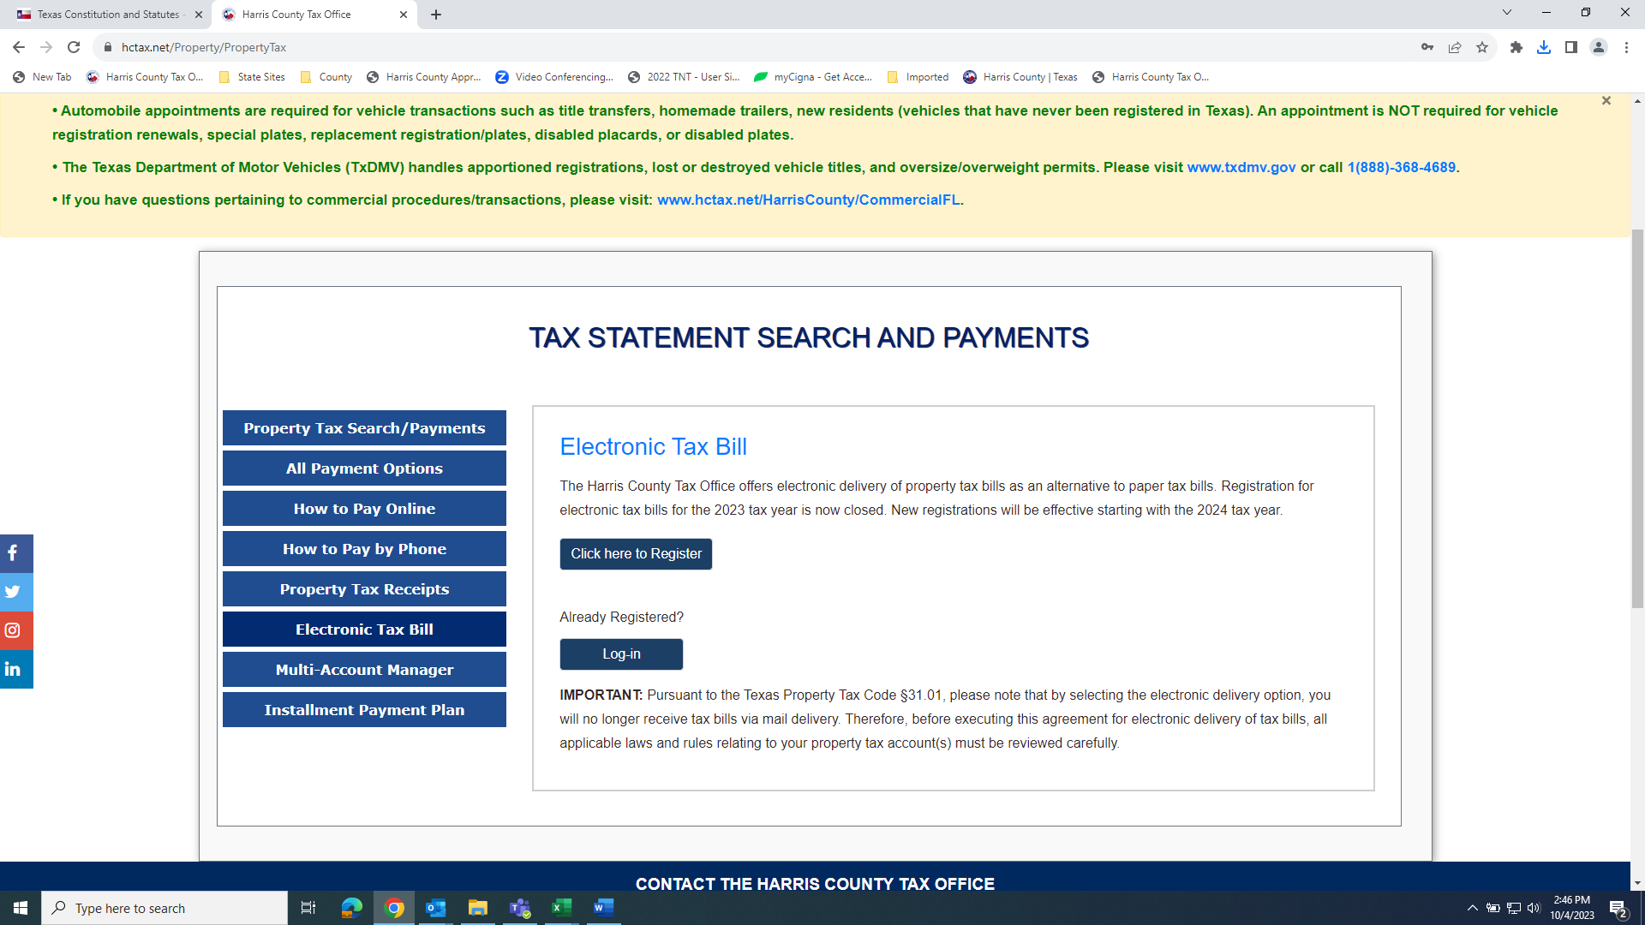
02
HCTO Online e-Bill Registration!
You will need a prior year tax bill, if you do not have one, contact the tax office and we will mail one to you
This bill contains that has an code that is needed to register for e-bills
This unique code is specific to each account number for security purposes
Once registered, you will no longer receive paper tax bill

Slide 10


New Message
JaneDoe@gmail.com
Property Tax Account: 2202912300000
Dear Jane Doe,
Your 2023 Harris County Property Tax E-Bills are now available.
To retrieve your 2023 Harris County Property Tax Statements, click on the link below or copy and paste the URL into your internet browser.
Tax Statements included in this URL:
2202912300000
https://www.hctax.net/Property/TaxStatement?EiD=20271&Account=EN//UPiw36HfNClC7cR1JpUpn99K29d4vlLEBILipLc=
This electronic delivery of your tax statement is in lieu of the paper statement.
Please do not reply to this email. If you did not submit this request, or you have questions, please contact the Harris County Tax Office at: Tax.Office@tax.hctx.net
Thank you,
Ann Harris Bennett
Harris County Tax Assessor-Collector
The statement was requested electronically according to Property Tax Code 31.01(k).

Slide 11

Need to change your e-bill preferences?
Already Registered?
IMPORTANT: Pursuant to the Texas Property Tax Code §31.01, please note that be selecting the electronic delivery option, you will no longer receive tax bills via mail delivery. Therefore, before executing this agreement for electronic delivery of tax bills, all applicable laws and rules relating to your property tax account(s) must be reviewed carefully.
Property owners are able to log in to their e-Bill account to change preferences such as email address or cancel to receive paper bills again.

Slide 12
Processing e-Bill
How HCTO handles e-Bill requests...
Mmm, how do you handle ...
Accounts are either input by property owner or HCTO staff into e-Bill software
Annually HCTO staff reveiws these accounts to determine if there has been an onwerhsip change.
If an account has had an ownership change reported by Harris Central Appraisal District (HCAD), the e-Bill is deactived
a Comptoller e-Bill agreement from a tax agent?
a request in which you can’t confrim ownerhsip?
sending e-Bills to taxpayers…website link or PDF attachment?

Slide 13
What else is required to send electronically?
Tax Statements
Delinquent Notices
Notice of Overages
Receipts

Slide 14
03
Online Property Tax Services
Appraisal District
Tax Office
Law Firm/Tax Sale

Slide 15
HCAD Online Services
iFile Protest
iFile Rendition
Homestead
1
2
3
Propoerty Owners file protest of value and also have the abliality to settle the appeal electronically
Business Owners can render their Business Personal Property
Property Owners can apply for Homestead Exemptions via moble app
Agents
Electronic Notices
Rendition Workshops
4
5
6
Agents are able to protest accounts and download files
Property Owners request notices electronically
Offer BPP virtual as well as in-person workshops

Slide 16

TAC Online
Services
Search tax accounts
Tax Statment
Tax Recipts
Online payment
Find tax rates
Tax Sales Info
FAQ & forms
Social media as well!

Slide 17

Perdue Brandon Tax Foreclosure Sale
Provides tax sale FAQ
Tax Sale Map
Tax Resale
Texas Communities Group assists in dealing with abandoned, dilapidated and problem properties

Slide 18
Online Tax Sales
Authority for Online Tax Sales
Rules for online tax sales
Are online tax sales required?

Slide 19
Online Tax Sales
The Online Auction Service Provider (OASP)
Authority to contract with an OASP
Selecting an OASP
How are OASP paid?

Slide 20
Online Tax Sales
The Online Auction
Bidder registration
Deposit requirement
Date & time of online auction
Bidding
  Proxy bidding
  Incremental bidding
Payment of winning bid
Deed

Slide 21

Harris County Property Auction app
Moblie app is available one week before tax sale
Provides near to real-time public info on properties
List both tax sale and executions

Slide 22
Delinquent Account Online Services
Tax Office
Delinquent Attorney
HC Property Auction App
Pay delinquint taxes
Request Payment plans
District Clerk
Properties for tax sale
Access up-to-date tax sale status
Daily Court Reveiw
View Citation
Original Petition
Interventions
Judgement
Excess Proceeds
Official Publication for Harris County Public Property Auction

Slide 23
Thank you!
Do you have any questions?
Elizabeth Doss
elizabeth.doss@tax.hctx.net
713-274-8011
Elizabeth Wiehle
ewiehle@pbfcm.com
713-802-6988

