Slide 1
Tax Transparency websites:
Am I doing it right?
Presented to the Texas School Assessor Association March 2024 by:
Cher Elzy, Tax Assessor/Collector, Irving ISD
Cheryl Jordan, Deputy Chief Appraiser, Dallas Central Appraisal District
Kevin Passons, Tax Assessor/Collector and Chief Appraiser, Rockwall Central Appraisal District
Peggy McCormick, Chief Deputy, Dallas County Tax Office

Slide 2
What is the tax transparency website (ttw)?
Website created by SB2, 86th Legislative Session
Owned (and paid for) by the CAD
Data updated & managed by Tax Offices, Tax Entities & CADs

Slide 3
What needs to be on this website?
Appraisal Information
Property’s Identification Number
Property’s Market Value
Property’s Taxable Value
The name of each taxing unit in which the property is located
Tax Rates
Rate to Maintain (RTM) (ISDs)/No-New-Revenue Tax Rate (NNR)
Voter-Approval Tax Rate (VAR)
Proposed Tax Rate
Estimated Amount of Taxes based on RTM/NNR and Proposed Tax Rate
Must be broken down for each taxing unit
Difference between the tax $ amount based on the RTM/NNR and the Proposed Tax Rate

Slide 4
What needs to be on this website? (cont.)
Notices (Recommended to upload actual Notice in addition to details)
Date, time, and location of the Public Hearing on proposed tax rate
Date, time, and location of the Public Meeting to adopt the tax rate
Worksheets
Contact Information
Specifically, the e-mail address at which the taxing unit is capable of receiving written comments regarding the proposed tax rate of the taxing unit
The ability for electronically submitted feedback from the property owner concerning the proposed tax rate
Owners must include their name, contact information, and physical address of the property

Slide 5
What needs to be on this website? (cont.)
Links to External Sites for:
The Internet website used by each taxing unit in which the property is located to post the information described by Tax Code Sec. 26.18
Tax Rate and Budget Information
The Internet database created by the Chief Appraiser under Section 41.13 that contains information regarding protest hearings conducted by the appraisal review board
THIS REQUIREMENT WAS ADDED DURING THE 88TH LEGISLATIVE SESSION BY HOUSE BILL 796

Slide 6
When do I have to put data on the website?
Before Adopting Tax Rates (It’s Just Good Practice)
Timely
As Soon As Possible
By August 7th

Slide 7
Why do I have to update this information?
To comply with Texas Property Tax Code Sections:
26.04
26.16
26.17
26.18
To be able to vote on the tax rate
It’s just good practice
It’s the LAW!!

Slide 8
Is there one right way to update the ttw?
CAD does everything?
County Tax Office does everything?
Each Taxing Entity enters their own data?
Who Cares? Let’s Just Do It!!

Slide 9
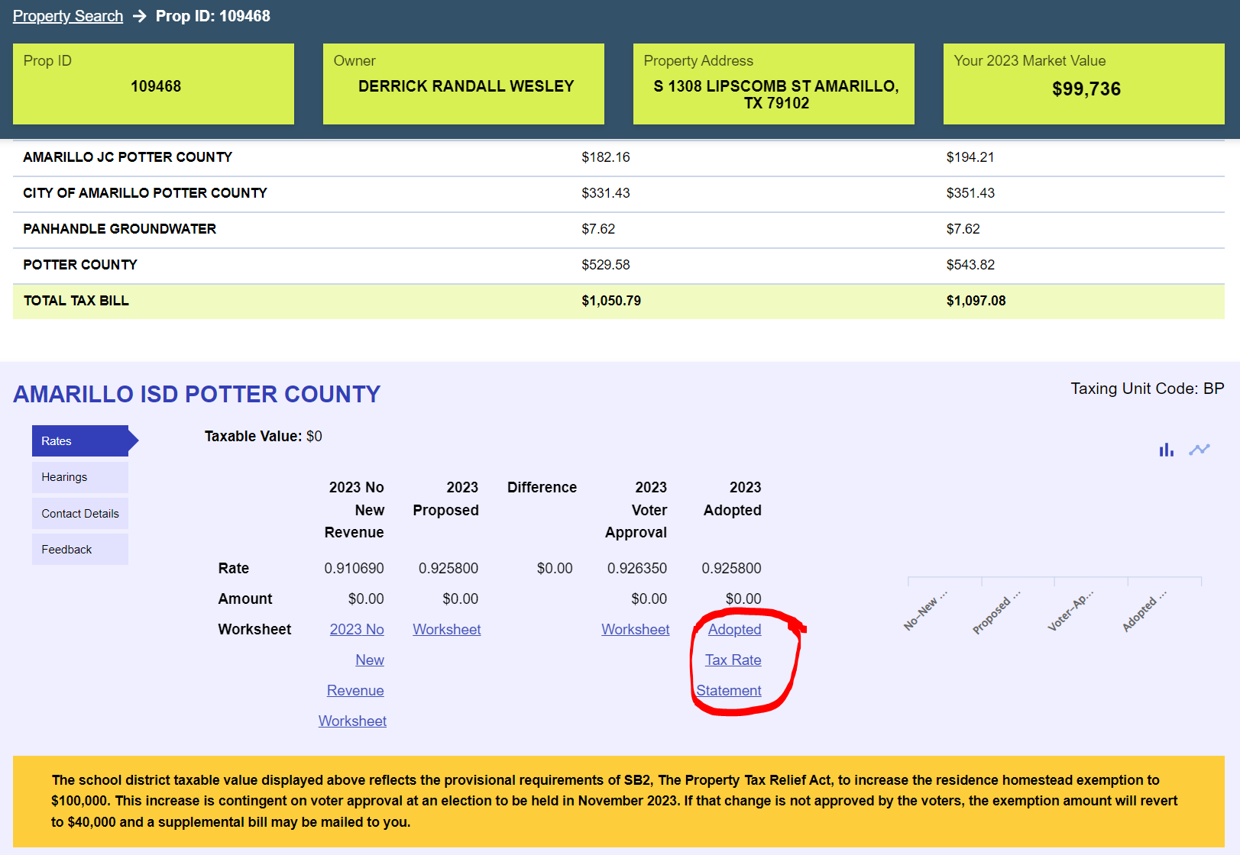
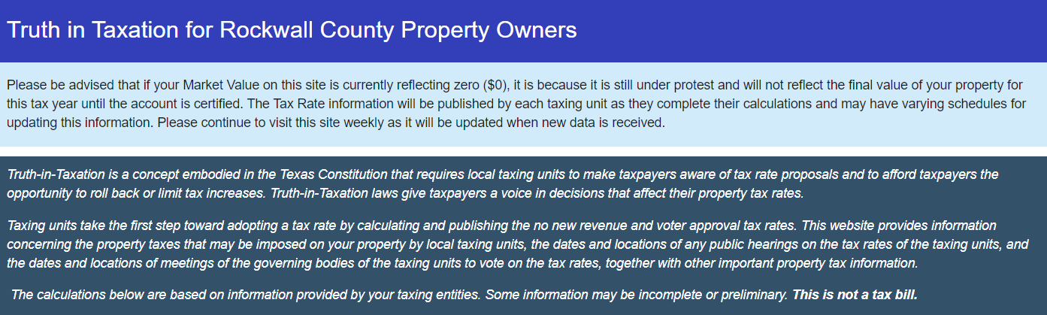
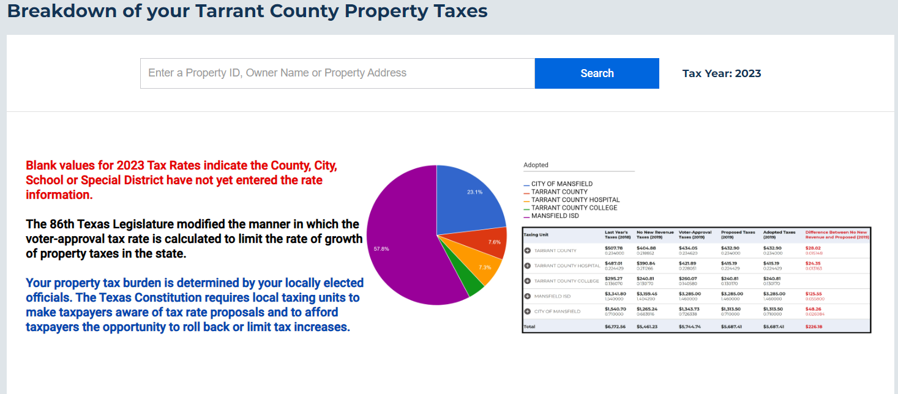
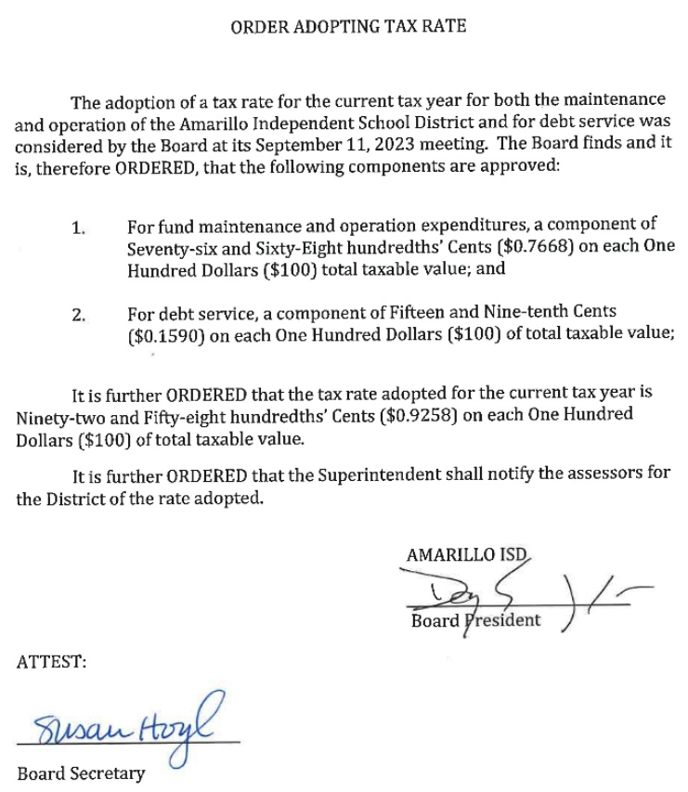

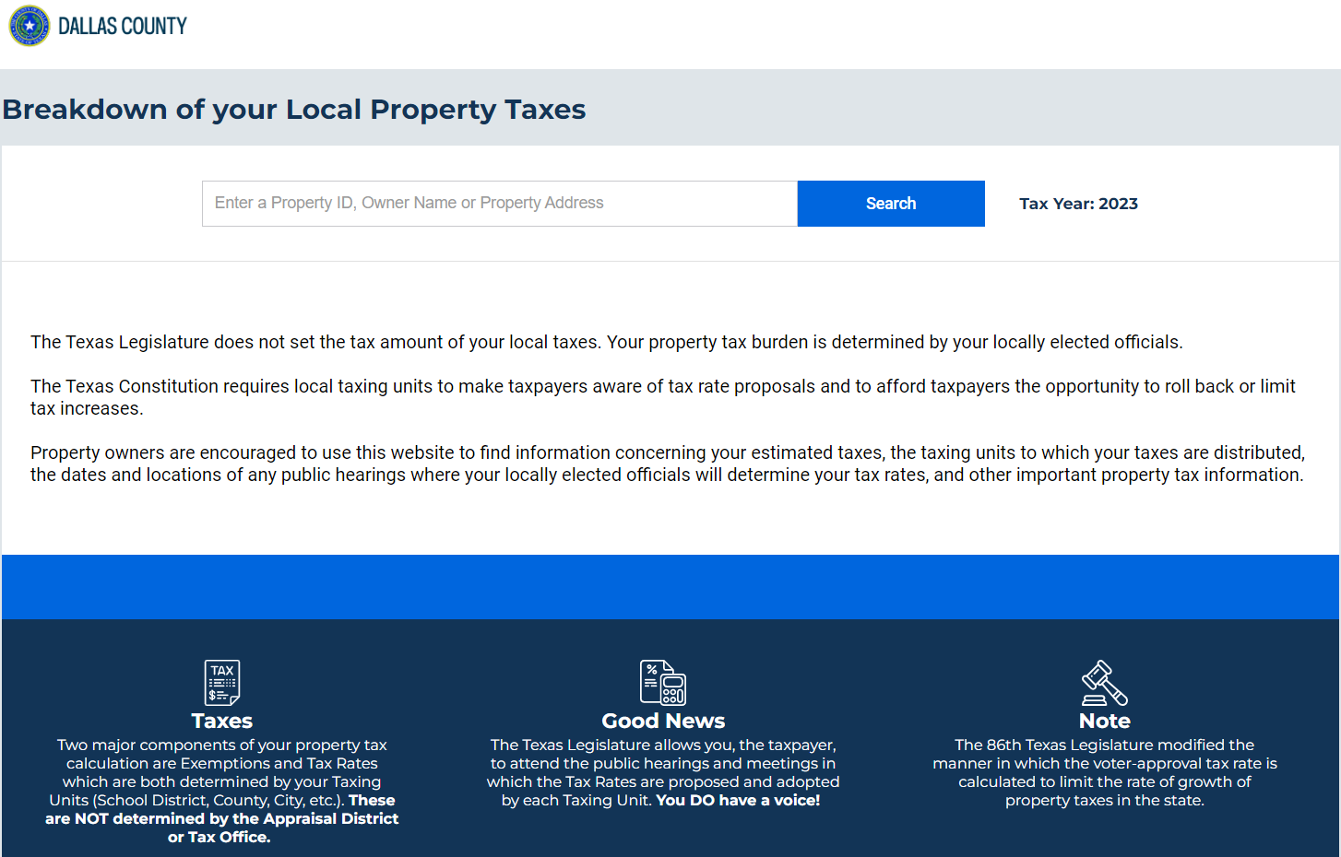
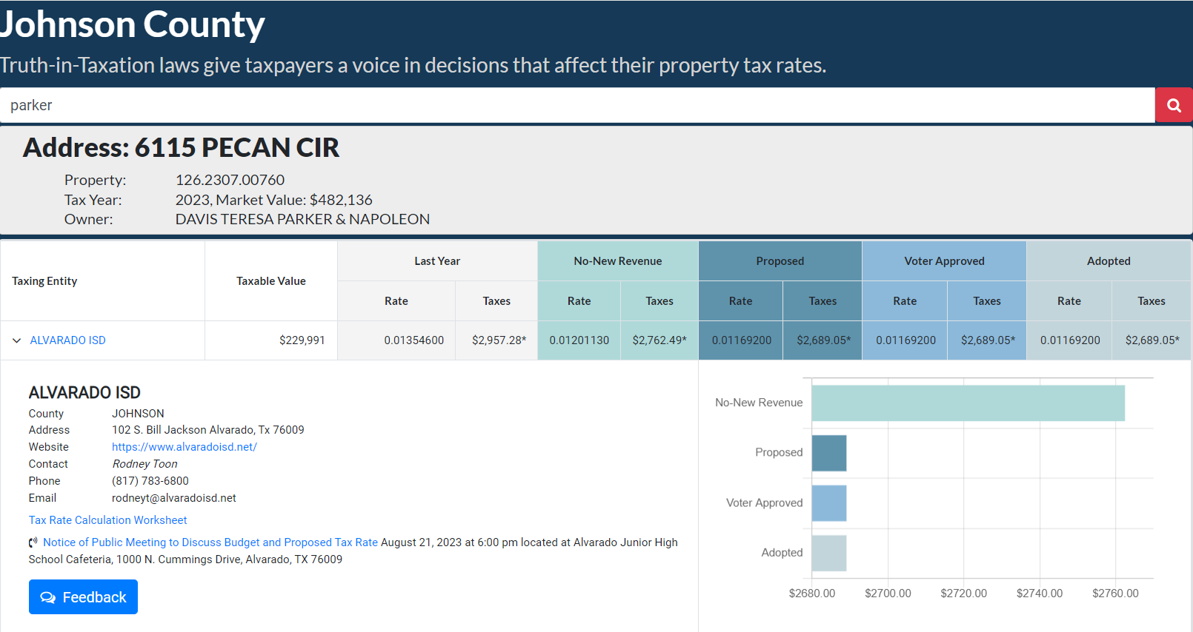

Slide 10
What can happen anyway??
Injunctions
Audits
Bad Press / Complaints
More Legislation

Slide 11
What is changing for 2024?
The TTW must include a link to the Internet database created by the Chief Appraiser under Section 41.13 that contains information regarding protest hearings conducted by the appraisal review board.
Added during the 88th Legislative Session by House Bill 796
The Appraisal District shall deliver email notifications to a property owner regarding updates to the property tax database if the property owner registers on the website to receive such notifications.
Added during the 88th Legislative Session by House Bill 3273

Slide 12
Let’s all work together
Tax Transparency Website
Tax Office
Appraisal District
Governing Body

Slide 13
Thank you!

